Slide 1
Journey Scrapbook
Akshat Gupta
Batch-6

Slide 2
Custom Training Week - 1
29-Aug-2023 to 01-Sept-2023

Slide 3
Day 1
Types of data – structured, semi structured, unstructured
Keys – Primary, foreign, candidate, composite, super and unique
Normalization and denormalization
1NF, 2NF, 3NF, BCNF
ER Diagram and activity on ER Modelling for a Bookstore
Dimension Modelling – Star vs Snowflake Schema
Slowly changing dimension

Slide 4
Day 2
Big Data
4Vs – Velocity, Volume, Veracity, Variety.
Batch vs Stream Data Processing
Data Warehouse and Data Lake and Lake House
Types of cloud – Public, Private and Hybrid
Cloud Service Models – Iaas, Paas, Saas.
Azure Fundamentals

Slide 5
Day 3
Creating Azure SQL
Create SQL Database using Single DB resource
Firewall rules – Allow azure services and resources to access this server - YES ; add current IP address – YES
Selecting Data source as Sample database
Going to query editor and enter server’s name and password

Slide 6
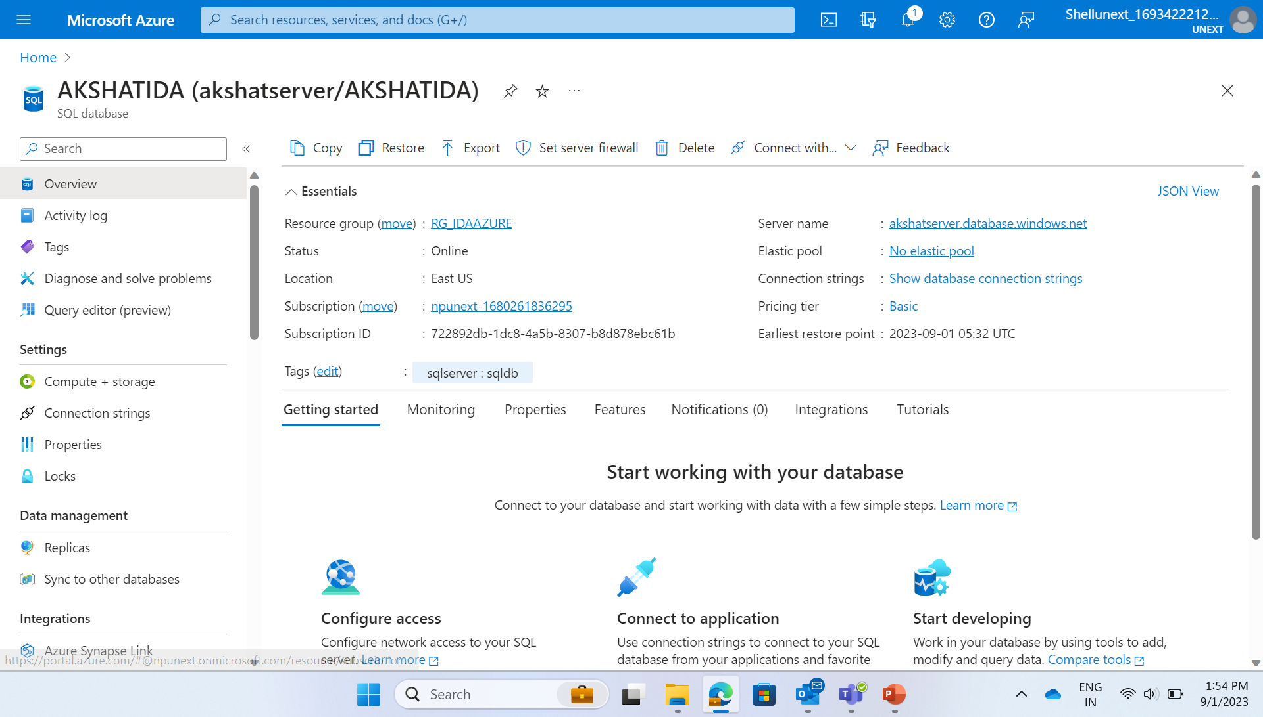

Slide 7
Day 4 – HANDS ON
Creating schema and then table in it
Writing various queries and executing them

Slide 8
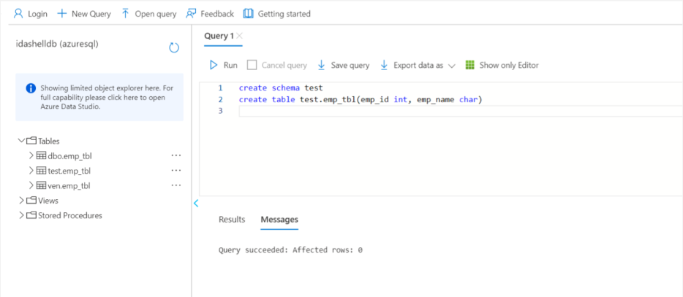

Slide 9
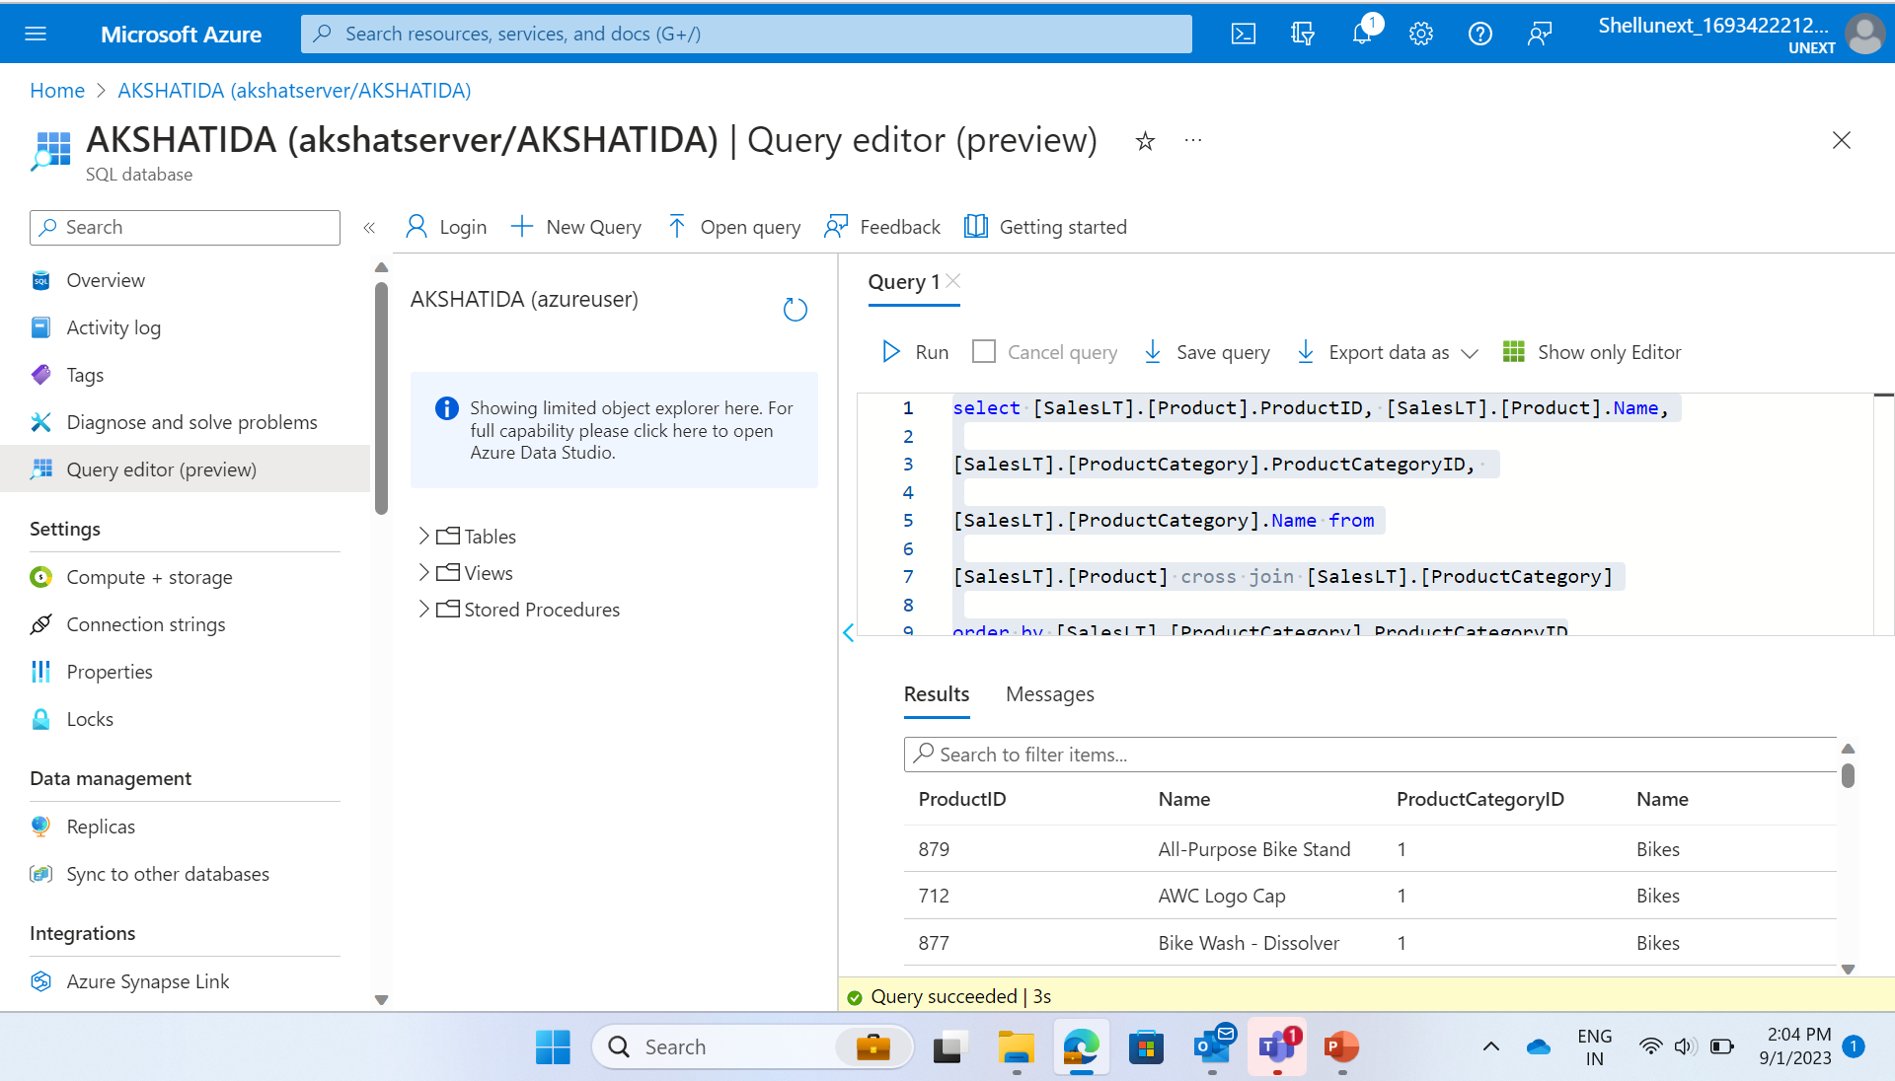

Slide 10
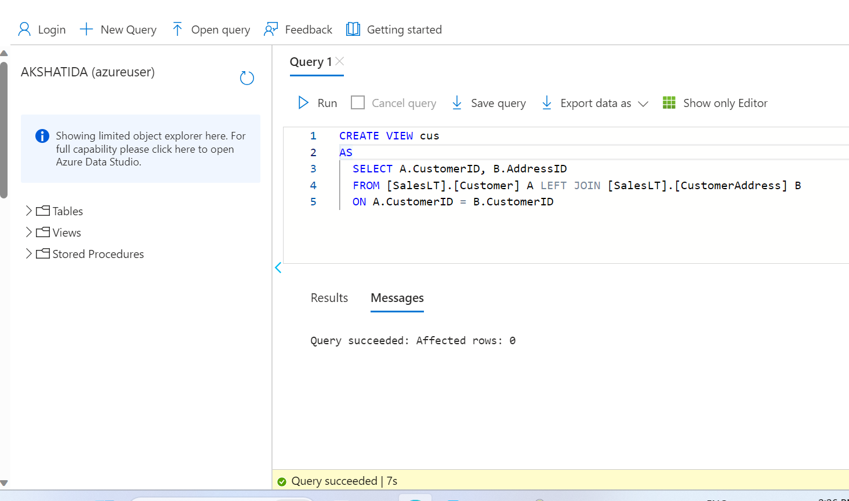

Slide 11
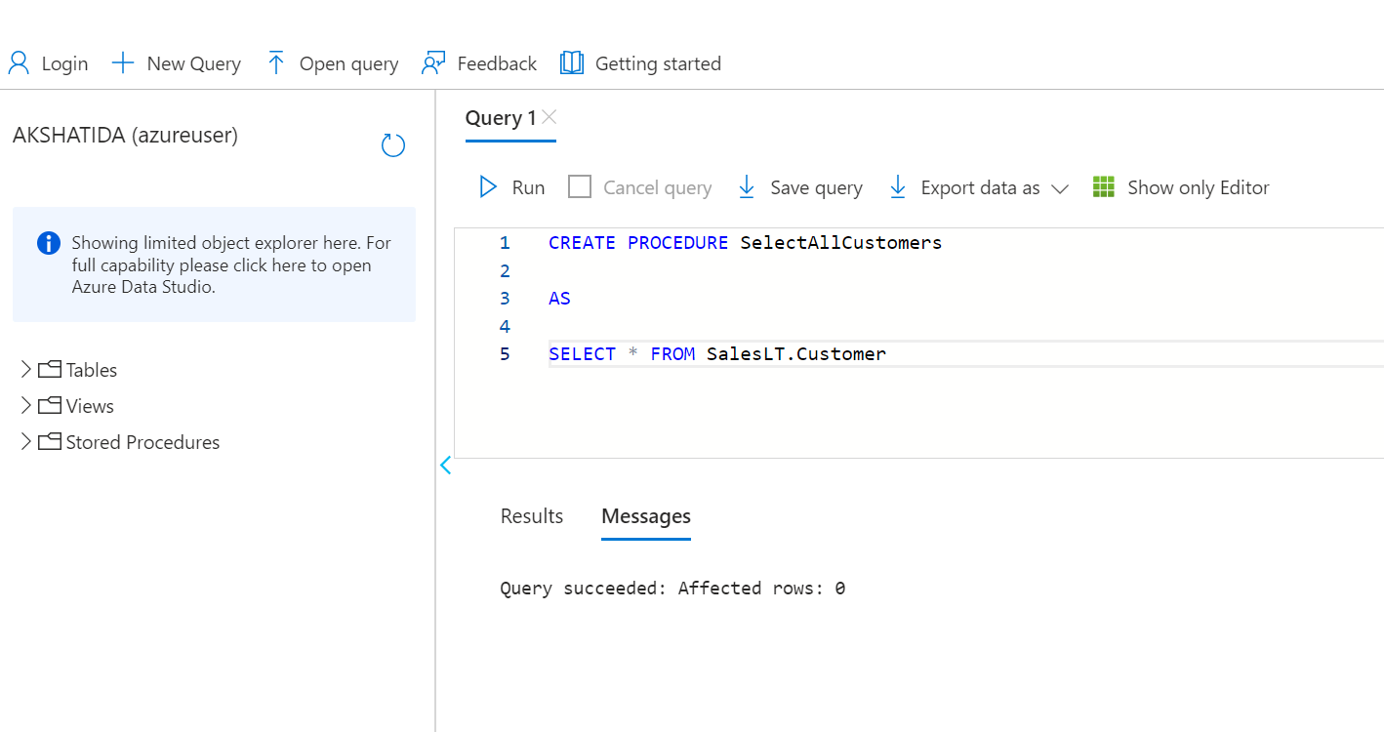

Slide 12
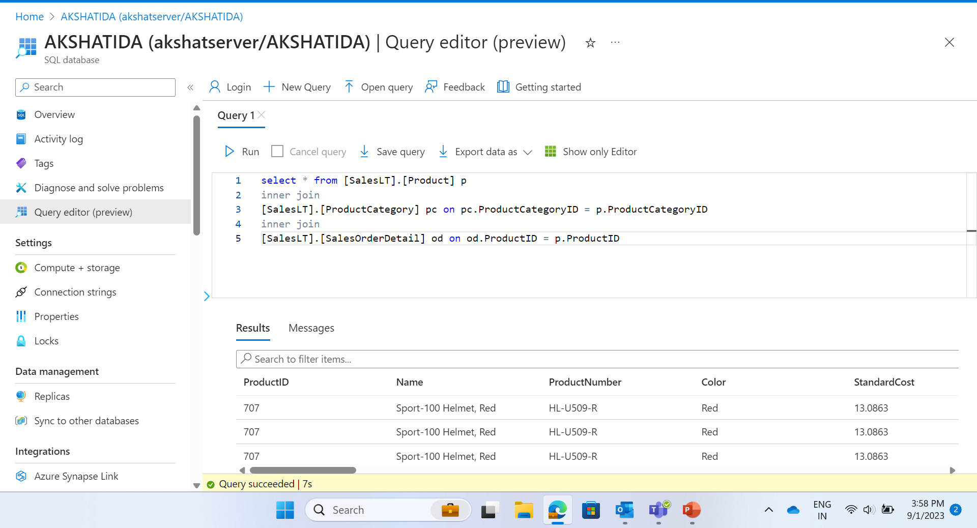

Slide 13
Thank you
Akshat Gupta
Akshat.gupta2@shell.com

